Slide 1
Phonics Screening Workshop
Wroughton Infant School

Slide 2
Why do we teach phonics?
Phonics is a way of teaching children to read skilfully. They are taught how to:
Recognise the sounds that each individual letter makes.
Identify the sounds that different combinations of letters make – such as ‘sh’ or ‘oo’.
Blend sounds together from left to right to make a word
Children can then use this knowledge to ‘decode’ new words that they see or hear. This is the first important step to learning to read and spell.

Slide 3
How to say pure sounds…
Resources - Year 1 | Letters and Sounds (littlewandlelettersandsounds.org.uk)

Slide 4
Some definitions…
Phonemes are the smallest unit of sound in a word e.g. d, f, sh, ch, ng
Graphemes are letters representing a phoneme e.g. dge, wh, tch, ph
Segmenting means sounding out and breaking down the individual sounds in a word in order to read it/spell it.
Blending is when we blend the sounds (phonemes) together to read the word aloud.

Slide 5
Digraph
Two letters, which make one sound
A consonant digraph contains two consonants
sh ck th ll
A vowel digraph contains at least one vowel
ai ee ar oy

Slide 6
Trigraph
Three letters, which make one sound
igh dge air

Slide 7
Split digraph
A digraph in which the two letters are not adjacent (e.g. make).
a-e i-e e-e o-e u-e

Slide 8
How many sounds (phonemes) in each word?
Word | Phonemes
Shelf | sh | e | l | f
Dress | d | r | e | ss
Think | th | i | n | k
String | s | t | r | i | ng
Sprint | s | p | r | i | n | t
Flick | f | l | i | ck

Slide 9
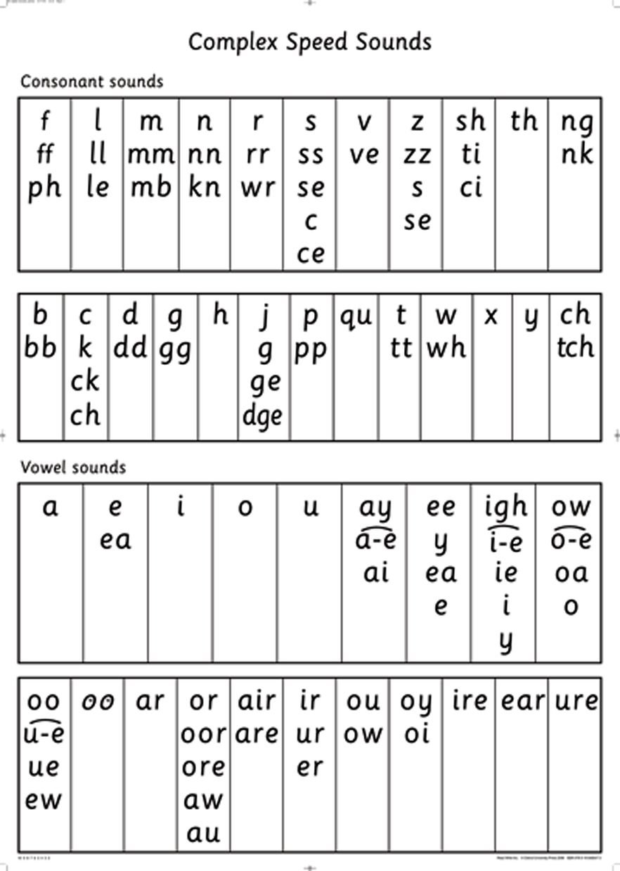
The same phoneme can be represented in more than one way

Slide 10
What is the Phonics Screening Check?
Children in Year 1 throughout the country will all be taking part in a phonics screening check and this year it will be the week beginning the 12th June.
Children in Year 2 will also take the check if they did not achieve the required result when in Year 1, or they have not taken the test before.
The phonics screening check is designed to confirm whether individual children have learnt phonic decoding and blending skills to an appropriate standard.

Slide 11
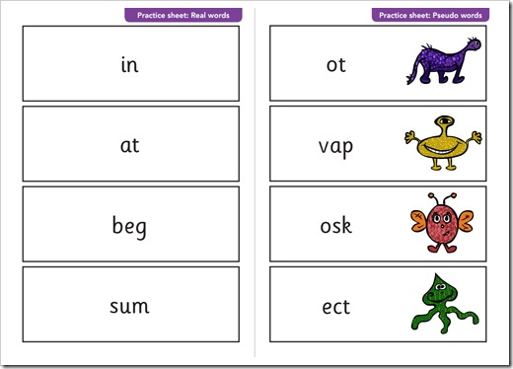
What happens during the check?
The check contains 40 words. Each child will sit one-to-one with their teacher and read each word aloud.
The test will take approximately 10 minutes per child, although all children are different and will complete the check at their own pace.
The list of words the children read is a combination of 20 real words and 20 pseudo words (nonsense words).

Slide 12
Pseudo words (nonsense words/ rubbish words/ alien words)
The pseudo words will be shown to your child with a picture of an alien.
Pseudo words are included because they will be new to all pupils; they do not favour children with a good vocabulary knowledge or visual memory of words.

Slide 13
What is allowed?
Children can either ‘sound talk’ and blend the word or just say the word.
Self-correction
Taking into account any difficulties with pronunciation.
General and impartial encouragement.
(okay, thank you and next)

Slide 14
What is not allowed?
Saying the phonemes without blending.
Being encouraged to have another go.
Having several goes and then having the correct one accepted.

Slide 15
Issues that have arisen previously …
Some children read nonsense words as real words, e.g. strom as storm.
Unfamiliar with vocabulary used in real word sections of the check.
Adjacent consonants e.g. nonsense words like strack may be misread as starck. This difficulty can be reduced through sounding out using fingers.

Slide 16
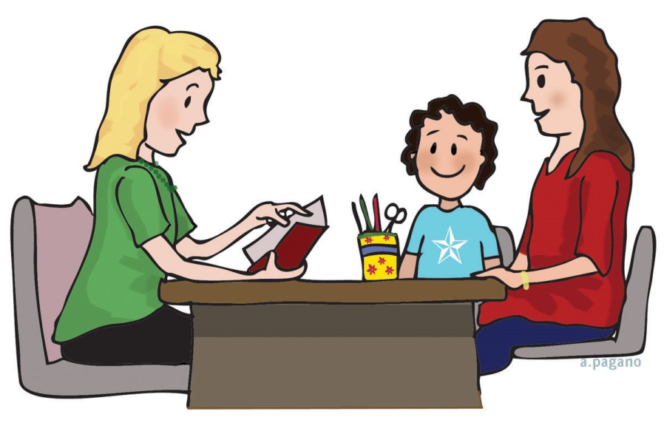
Reporting to parents
By the end of the summer term all schools must report each child's results to their parents. They will also confirm if the child has met the standard threshold. Children who do not achieve the expected level will retake the test when they are in Year 2.

Slide 17
How are the results used?
Results from the check will be used by schools to analyse their own performance and for Ofsted to use in inspections.

Slide 18
How can I help my child at home?
Play lots of sound and listening games with your child
Read to and with your child as much as possible.
Encourage and praise – get them to have a ‘good guess’.
If your child is struggling to decode a word, help them by encouraging them to say each sound in the word from left to right.
Blend the sounds by pointing to each one, e.g. /c/ in cat, /p/ in pat, /ng/ in sing, /ee/ in been. Next move your finger under the whole word as you say it.
Discuss the meaning of words if your child does not know what they have read.

Slide 19
Resources
Google play app store – (hairy phonics 1, hooked on phonics, phonics sound match game, phonic puzzles).
App store iphones – (hooked on phonics, phonics genius, pirate phonics)

Slide 20
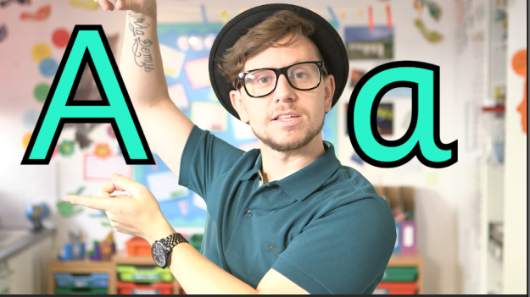
Mr Thorne Does Phonics

Slide 21
DO YOU HAVE Any questions?

